Slide 1
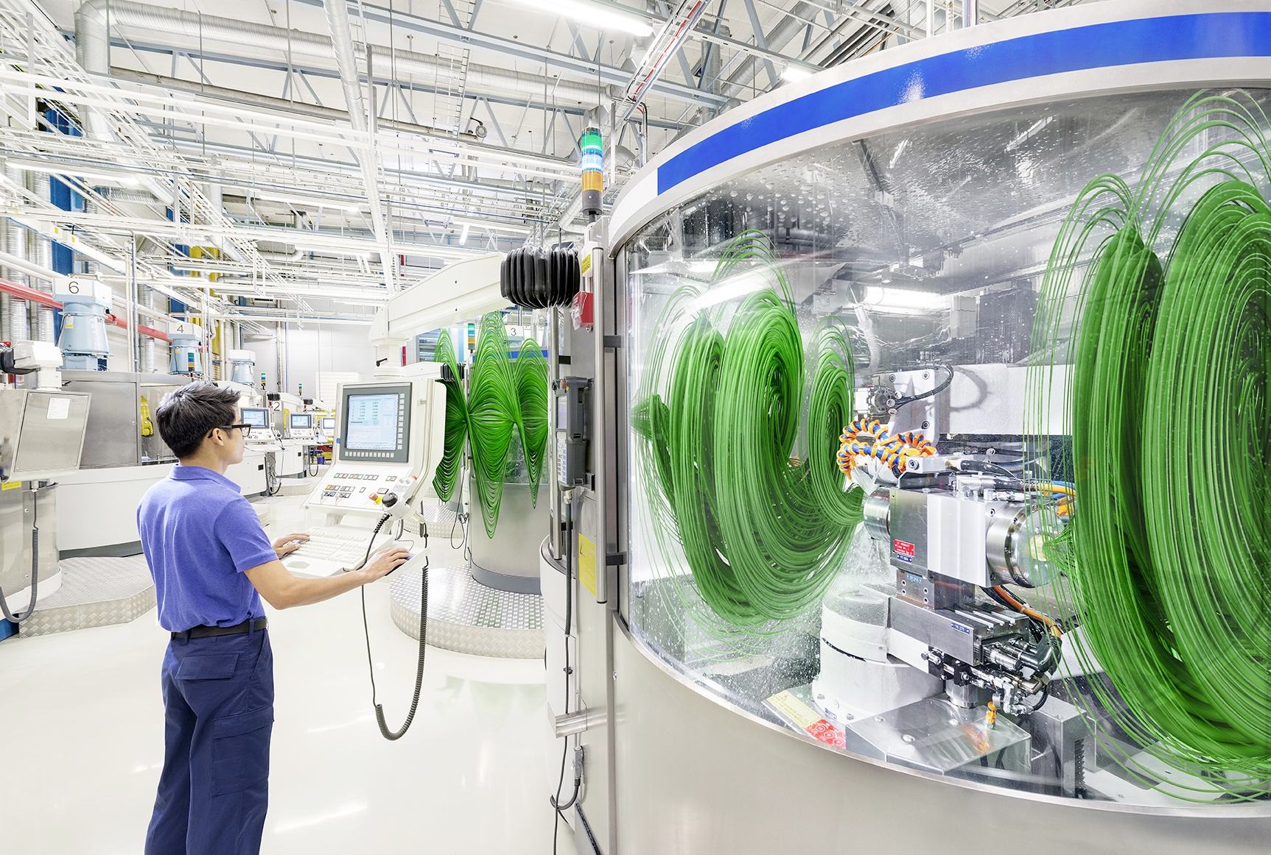

CASTROL HYSOL SL 30 XBB
Semi-synthetic metalworking fluid provides improved machining performance for ferrous alloys
TM

Slide 2
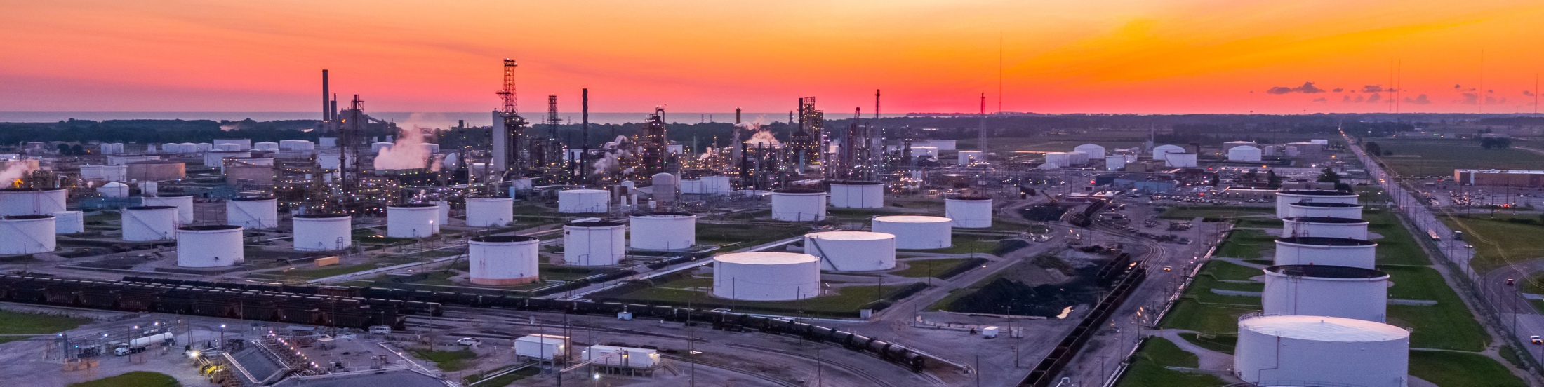
CONTENTS
1
WHO WE ARE – CASTROL & BP
4
CASE STUDIES
  Castrol and BP
  Our heritage
  Proven in field (Case Studies)
2
5
LAB TEST RESULTS
METALWORKING FLUIDS
  Current market trends
  What do you expect from your coolants?
  Requirements from customers
  and distributors
Overview
Alkalinity
Microbiology challenge test
Foaming properties – CNOMO
Hard-water stability
Foaming properties – SITA
Recirculation test
Residue test
Corrosion protection
Tapping
BUS-MODEL: Skin Compatibility
3
CASTROL’S SOLUTION
  Castrol Hysol SL 30 XBB
  Application guidance and technical data

Slide 3
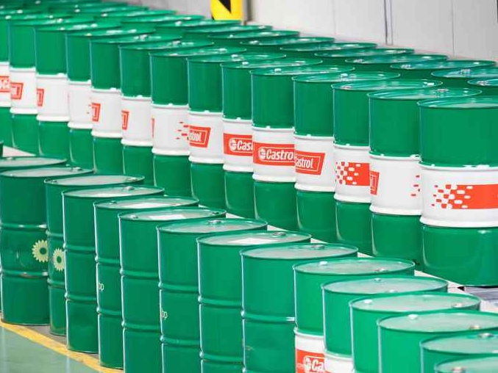
SECTION 1
WHO WE ARE

Slide 4

WHO WE ARE – CASTROL & BP
BP
BP is one of the world’s leading international
oil and gas companies
We employ over
74,500 people
We have operations
on six continents
and in over 80 countries
CASTROL
Castrol (BP Lubricants) was founded in 1899 by Charles Cheers Wakefield
We operate directly in over
46 countries
We market our products to
over half a million customers
in 120 countries
We employ 7,500 people worldwide

Slide 5







CASTROL:
A SPECIALIST LUBRICANTS BUSINESS AND PART OF BP
WHO WE ARE – CASTROL & BP
BP delivers energy products and services to people around the world.
UPSTREAM
DOWNSTREAM
FINDING
OIL AND GAS
DEVELOPING
AND EXTRACTING
OIL AND GAS
TRANSPORTING
AND TRADING
OIL AND GAS
MANUFACTURING
FUELS AND
PRODUCTS
MARKETING
FUELS AND
PRODUCTS
FUELS, LUBRICANTS
AND PETROCHEMICALS
INTERNATIONAL OIL
AND GAS MARKETS
GENERATING RENEWABLE ENERGY

Slide 6
OUR TECHNOLOGY AND MANUFACTURING
CENTRES FOR INDUSTRIAL PRODUCTS
WHO WE ARE – CASTROL & BP
PANGBOURNE,
UK
MÖNCHENGLADBACH,
GERMANY
LANDAU,
GERMANY
PÉRONNE,
FRANCE
TAICANG,
CHINA
NAGOYA,
JAPAN
NAPERVILLE,
ILLINOIS
WARMINSTER,
PENNSYLVANIA
SHANGHAI,
CHINA
MUMBAI,
INDIA
MELBOURNE,
AUSTRALIA
Production centre
Technology centre

Slide 7
Current Market Trends
To remain competitive, manufacturers are increasingly focused on eliminating waste and inefficiencies
Manufacturing industries are constantly under pressure to improve their operational processes
Stricter legislation can increase cutting fluid disposal costs, and can limit the use of chemicals once widely used in manufacturing
Machining excellence cannot be compromised
Choosing the optimum cutting fluid is key in helping to future-proof production
What do you expect from your coolants?
Have a long life (e.g. it does not become contaminated rapidly)
Not require excessive usage of biocides to keep it fresh
Perform well and meet specifications
Provide product consistency – to specification, every time
Does not cause problems with machines or with personnel (e.g. skin irritation)
Works well and prevents downtime across different metal types
Be eco-friendly

Slide 8


Requirements from customers and distributors
Suitable across ferrous alloys (like cast iron) machining
Improved anti-corrosion performance and pH stability
Low foam in soft and hard water conditions
Meet current and future regulatory requirements for health, safety and waste treatment

Slide 9
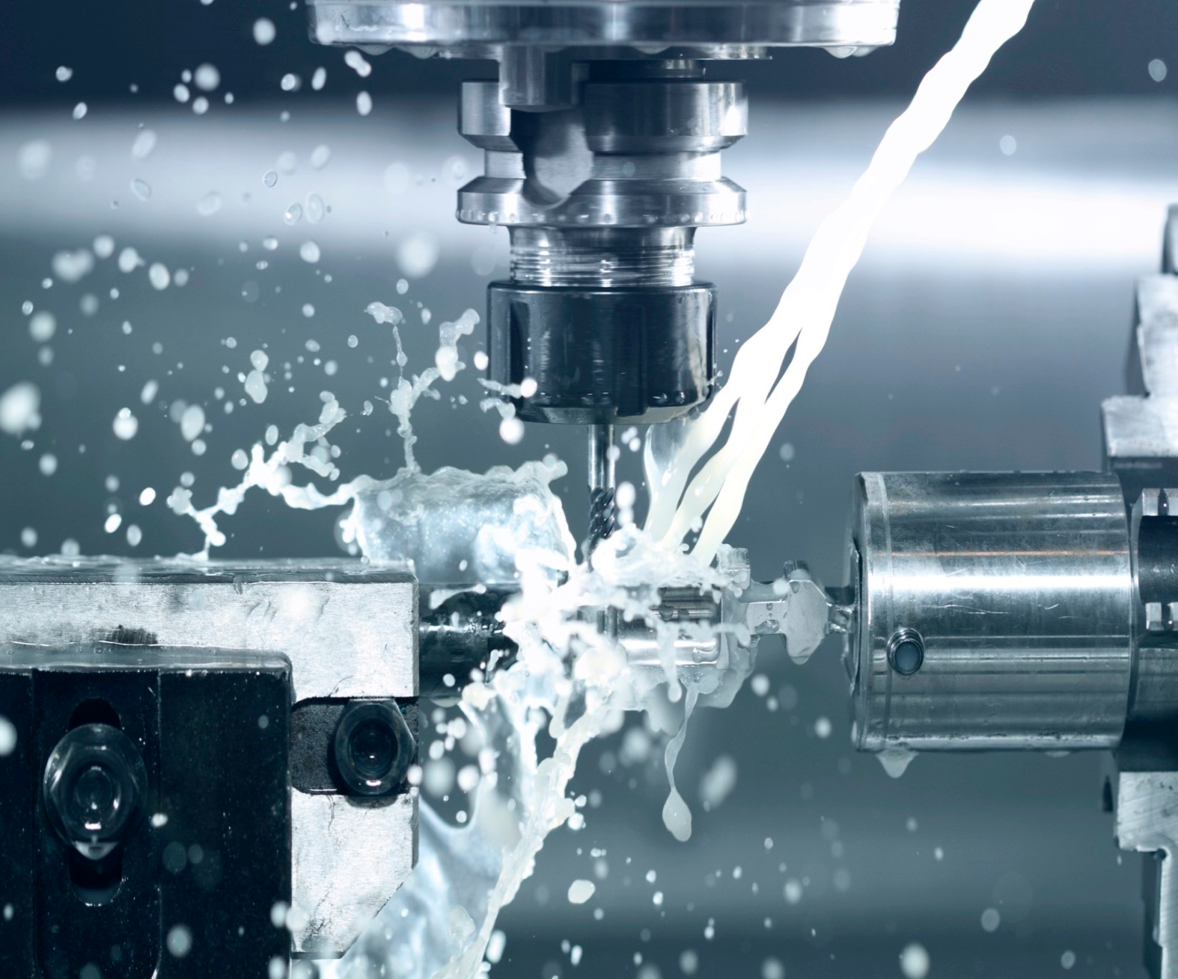
HYSOL SL 30 XBB
Semi-Synthetic Metalworking Fluid
Overcome the severe requirements of foam, long emulsion stability and anti-corrosion performance
Formulated without boron, DCHA, formaldehyde releasing agent, and monoethanolamine.

Slide 10

Application Guidance and Technical Data of Hysol SL 30 XBB
 | Cast Iron | Low alloyed steel | High alloyed stainless steel | Aluminum Alloys | Yellow Metals
Grinding | • • | • • | • •
Milling, turning (general machining) | • • | • • | •
Drilling | • • | • •
Reaming, tapping | • • | •
Broaching | • • | •
• Possible application, please consult Castrol representative prior to use • • Suggested core application
Concentrate
Mineral oil [%] | 30
EP/AW-Additive | Yes (P)
Boron/Formaldehyde | Free
Emulsion
Appearance | Translucent to Milky
pH-value (4 %) | 9,7
Grinding 4-6%
General Machining 5-10%
Water range 200-800 ppm CaCO₃

Slide 11
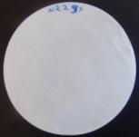
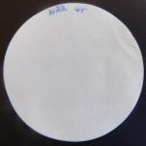
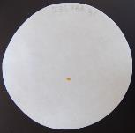
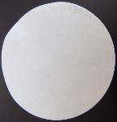
Chip Corrosion Test – DIN 51360/2 20°dH (CIP 507-02)
Hysol SL 30 XBB vs. Standard Cast Iron Coolant
Hysol SL 30 XBB
3% = 0/1
4% = 0/0
Standard Cast Iron Coolant
3% = 1/1
4% = 0/0

Slide 12
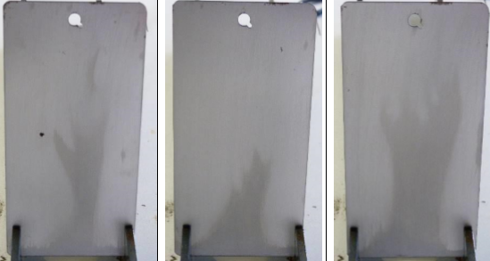
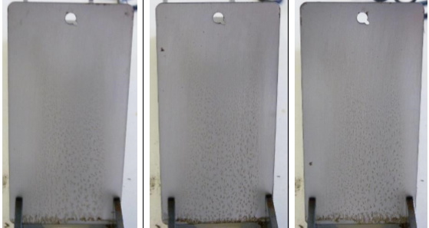
Humidity Chamber Testing, 5% in VE
Hysol SL 30 XBB vs. Standard Cast Iron Coolant
Conclusion After 7 Days on 3 samples
Standard Cast Iron Coolant: Significant corrosion at all concentrations
Hysol SL 30 XBB: No corrosion at all concentrations (partly slightly corrosion on 1 of 3 panels per concentration)
The Q-Panels were cleaned with benzine.
One side was polished with Aluminium oxide cloth 240 grid.
The panels were submerged in emulsion for one minute and dried at room temperature for 20-60 minutes.
The panels were placed in a Weiss WK 111 humidity chamber at 48°C and 90% relative humidity for 7 days
Hysol SL 30 XBB
Standard Cast Iron Coolant
Slightly Corrosion Visible
No Corrosion Visible
No Corrosion Visible
Corrosion Visible

Slide 13
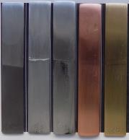
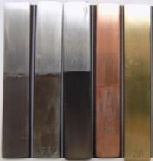
Aluminium and Yellow Metal Compatibilty
Test Conditions:
6% Emulsion of Hysol SL 30 XBB
in 100 ppm CaCO₃, room temperature
Test duration of 48 hours
Hysol SL 30 XBB
Standard Cast Iron Coolant
ADC12
6063
7075
Cu
Brass
ADC12
6063
7075
Cu
Brass

Slide 14
Alkalinity 4% in 20 °dH
Hysol SL 30 XBB
Standard Cast Iron Coolant
Product | Start pH-value | pH 7 - ml HCl (0.1M) | pH 8 - ml HCl (0.1M)
Standard Cast Iron Coolant | 9.7 | 61 | 45
Hysol SL 30 XBB | 9.6 | 60 | 44

Slide 15
Microbiology Testing
Internal microbiology challenge test over a 4-week period (5%, 200 ppm)
Bacteria
 | Days
Product | 3 | 7 | 10 | 14 | 17 | 21 | 24 | 28 | PID 1 | PID3
Hysol SL 30 XBB | 0,00E+00 | 0,00E+00 | 0,00E+00 | 1,00E+03 | 0,00E+00 | 1,00E+03 | 0,00E+00 | 2,00E+04 | 1,00E+03 | 0,00E+00
Standard Cast Iron Coolant | 1,00E+02 | 0,00E+00 | 0,00E+00 | 0,00E+00 | 0,00E+00 | na | 0,00E+00 | 0,00E+00 | 0,00E+00 | 0,00E+00
Fungi
 | Days
Product | 3 | 7 | 10 | 14 | 17 | 21 | 24 | 28 | PID1 | PID3
Hysol SL 30 XBB | 0,00E+00 | 0,00E+00 | 0,00E+00 | 0,00E+00 | 0,00E+00 | 0,00E+00 | 0,00E+00 | 0,00E+00 | 0,00E+00 | 0,00E+00
Standard Cast Iron Coolant | 0,00E+00 | 0,00E+00 | 0,00E+00 | 0,00E+00 | 0,00E+00 | na | 0,00E+00 | 1,00E+01 | 0,00E+00 | 0,00E+00
pH-Value
Product | Start | 1st Week | 2nd Week | 3rd Week | End | (Start-End)
Hysol SL 30 XBB | 9,50 | 9,24 | 9,30 | 9,17 | 9,18 | -0,32
Standard Cast Iron Coolant | 9,51 | 9,36 | 9,49 | 9,37 | 9,38 | -0,13

Slide 16
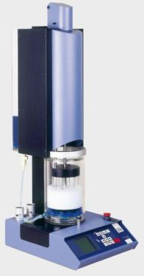
SITA foam test – 6% 100ppm, CIP 514-06
Standard Cast Iron Coolant
Hysol SL 30 XBB
Standard Cast Iron Coolant filtered
Hysol SL 30 XBB filtered
Standard Cast Iron Coolant
Hysol SL 30 XBB
Standard Cast Iron Coolant filtered
Hysol SL 30 XBB filtered
After 24h emulsions were filtered (8µM) and again a SITA foam test was performed.

Slide 17
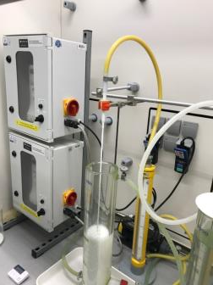
6% Emulsion, 100ppm (CIP1004), Emulsion tested without defoamer in the concentrate
CNOMO Foam Test
Standard Cast Iron Coolant Day 1
Standard Cast Iron Coolant Day 2
Hysol SL 30 XBB Day 1
Hysol SL 30 XBB Day 2

Slide 18
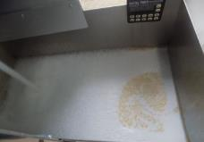
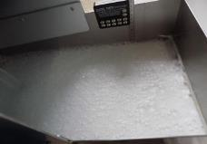
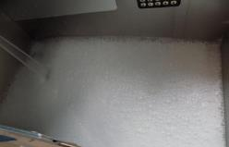
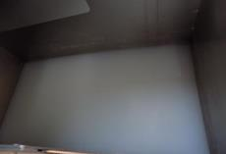
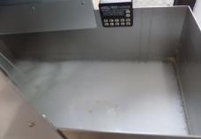
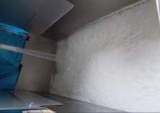
Recirculation Test (in house Renault)
Hysol SL 30 XBB
Bath: 5% 25l
No oil/no split
 | Day 1 | Day 2 | Day 3 | Day 4 | Day 5 | Day 8
Water hardness / Nozzle | Tap water (12°dH) No nozzle | Tap water (12°dH) Nozzle 1 | Tap water (12°dH) Nozzle 0.5 | 35°dH Nozzle 0.5 | 50°dH Nozzle 0.5 | 50°dH Nozzle 0.5
Emulsion Appearance | good; nearly no foam, less soaps on surface 1 g soaps | good; big foam bubbles, fast decay 1.4 g soaps | good; less foam than day 2, fast decay 0.3 g soaps | good; nearly no foam, fast decay 0.3 g soaps | good, nearly no foam, fast decay 2 g soaps | Good, no oil, no creme, low foam, small layer of soaps 22 g soaps
Day 1
Day 2
Day 3
Day 4 (before run)
Day 5
Day 8

Slide 19
Recirculation Test (in house Renault)
Hysol SL 30 XBB
Product passes test, when these criteria are met:
- no overflow
- no emulsion split
- total soap amount below 80 g (here: 27g)
Day 1
Day 2
Day 3
Day 4 (before run)
Day 5
Day 8

Slide 20
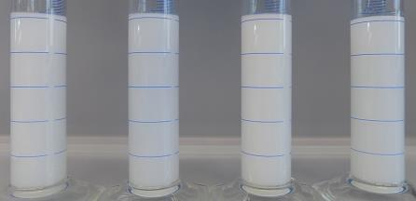
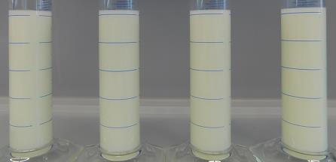
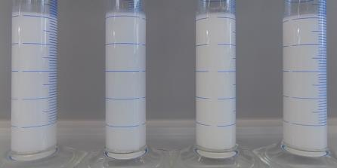
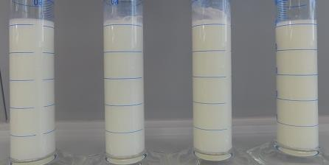
Emulsion Appearance (4%) after foam shaking test,
CIP 514-01
No significant differences in foam height and foam decay between both products
Hysol SL 30 XBB (directly)
Standard Cast Iron Coolant (directly)
5°dH 20°dH 40°dH 60°dH
5°dH 20°dH 40°dH 60°dH
Hysol SL 30 XBB (48h)
Standard Cast Iron Coolant (48h)
5°dH 20°dH 40°dH 60°dH
5°dH 20°dH 40°dH 60°dH

Slide 21










Emulsion compatibility
With Standard Cast Iron Coolant
directly
Emulsions: 20°dH 4%
directly: picture was taken after foam shaking test
after 24h: foam shaking test was repeated, afterwards picture was taken
 | Standard Cast Iron Coolant | Hysol SL 30 XBB
1 | 100% | 0%
2 | 75% | 25%
3 | 50% | 50%
4 | 25% | 75%
5 | 0% | 100%
1 2 3 4 5
after 24h

Slide 22
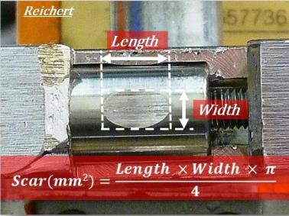
Results Reichert- wear test
CIP 525
Product | Wear surface [mm²] | Noise meter [m]
Hysol SL 30 XBB | 26 | >100
Standard Cast Iron Coolant | 29 | >100
wear: 1,5kg
10% emulsion
DI water

Slide 23
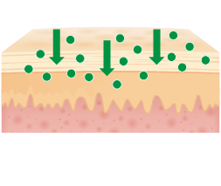


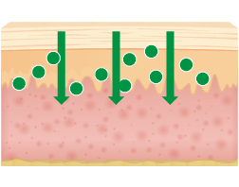


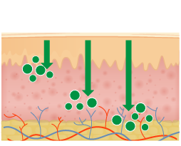

Lab Test Results
Skin Compatibility
The BUS* skin model
Dr. Wolfgang F. Pittermann, Certified Veterinary Pathologist
Conclusion: Based on the score evaluation after an open topical application (exposure period: 0.5hrs, 1.0hr, 5.0hrs, 1x appl.; unstripped skin) it can be concluded that the product Hysol SL 30 XBB (fresh; 20%) is non-irritant to the skin, even after repeated skin contact.
TEST MATERIAL
APPLICATION
PENETRATION, PERMEATION, ABSORPTION
INVESTIGATION METHODS
Pharma, cosmetics, household/industry chemicals, working materials, medical devices
Open/occlusive
2 x 600–800cm²
Analytical Method
Skin biopsy, Histoshaver (skin sections),
Horny layer strippings, Dermatome cuts,
Perfusion liquid
Epidermis
Biochemical Method
Cytotoxicity: e.g. MTT, Inflammatory mediators: e.g. PGE₂, enzymes:
e.g. LDH, SDH (V-max)
Dermis
Morphological Method
Histology, scanning electron microscopy,
V-max method
Cutis
* Bovine Udder Skin (isolated perfused udder skin)
(Kietsmann et al. 1993)

Slide 24

PLEASE CONTACT:
TM

